Slide 1

Review: Paper Reading BERT: Pre-training of Deep Bidirectional Transformers for Language Understanding
范老师
2020/06/07

Slide 2
Content
Introduction
Related Work
BERT
Experiments
Ablation Studies
Conclusion

Slide 3
Introduction
BERT：Bidirectional Encoder Representations from Transformers
Bidirectional pre-training for language representations
Pre-trained representations reduce the need for many heavily-engineered task-specific architectures
Fine-tuning without doing much work
BERT advances the state of the art for 11 NLP tasks.

Slide 4
Related Work
2.1 Unsupervised Feature-based Approaches (not bidirectional)
Left-to-right language modeling objectives have been used, as well as objectives to discriminate correct from incorrect words in left and right context.
Extract context-sensitive features from a left-to-right and a right-to-left language model.（但不同时，左右，只是拼接：EMLo）
2.2 Unsupervised Fine-tuning Approaches
Sentence or document encoders which produce contextual token representations have been pre-trained from unlabeled text and fine-tuned for a supervised downstream task
2.3 Transfer Learning from Supervised Data

Slide 5
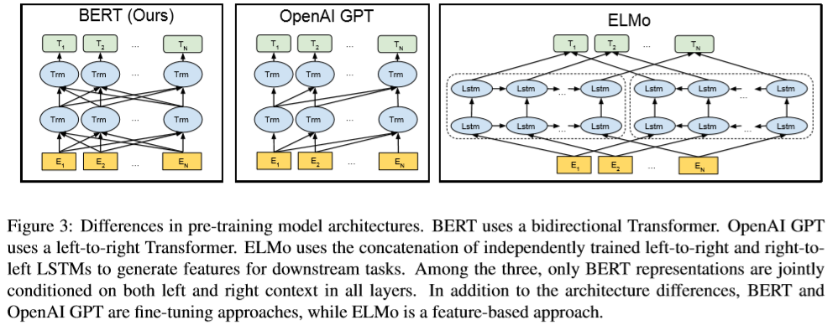
Related Work

Slide 6
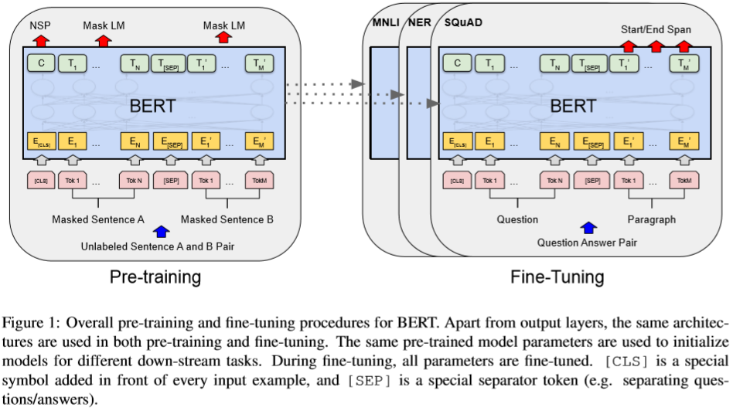
BERT
Notes:
下游任务的参数都是一样的，但是fine-tuning的结构不一样，图中显示的是问答类任务的fine-tuning结构

Slide 7
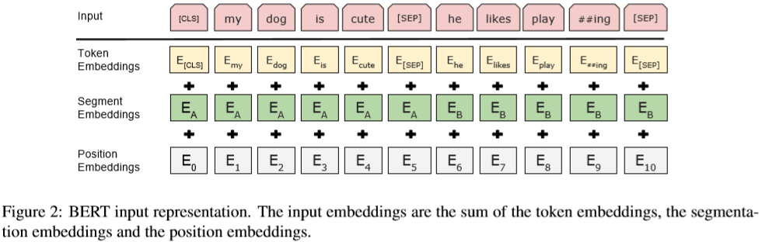
BERT
Notes:
下游任务的参数都是一样的，但是fine-tuning的结构不一样，图中显示的是问答类任务的fine-tuning结构

Slide 8
BERT-Pre-training BERT 一起训练的，不仅可以做token级别还可以做sentence级别
Task #1: Masked LM 词级别 强迫模型左右看，猜，就会计算self-attention
Mask language model: only predict masked words (15% tokens) + an output softmax over the vocabulary
Data generation: the training data generator chooses 15% of the token positions at random for prediction. If the i-th token is chosen, we replace the i-th token with (1) the [MASK] token 80% of the time (2) a random token 10% of the time (3) the unchanged i-th token 10% of the time. Then, Ti will be used to predict the original token with cross entropy loss. We compare variations of this procedure in Appendix C.2.
Task #2: Next Sentence Prediction (NSP) 句子级
Data generation: when choosing the sentences A and B for each pretraining example, 50% of the time B is the actual next sentence that follows A (labeled as IsNext), and 50% of the time it is a random sentence from the corpus (labeled as NotNext).

Slide 9
BERT-Fine-tuning BERT
Plug in the task specific inputs and outputs into BERT and finetune all the parameters end-to-end.
INPUT:
Sentence A and sentence B from pre-training are analogous to (1) sentence pairs in paraphrasing, (2) hypothesis-premise pairs in entailment, (3) question-passage pairs in question answering, and (4) a degenerate text-∅ pair in text classification or sequence tagging.
OUTPUT:
The token representations are fed into an output layer for token level tasks, such as sequence tagging or question answering, and the [CLS] representation is fed into an output layer for classification, such as entailment or sentiment analysis.

Slide 10
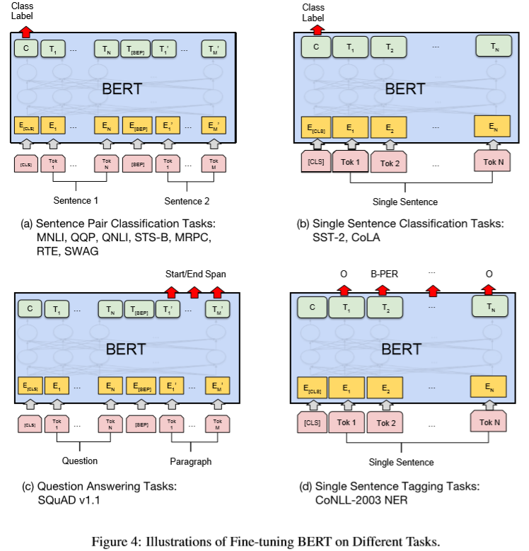
BERT- Fine-tuning BERT

Slide 11
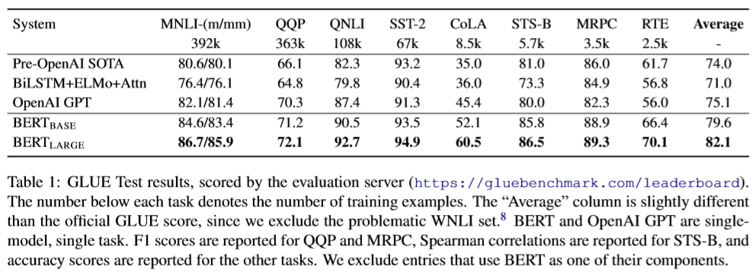
Experiments - GLUE

Slide 12
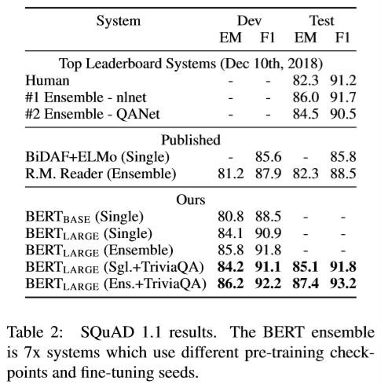
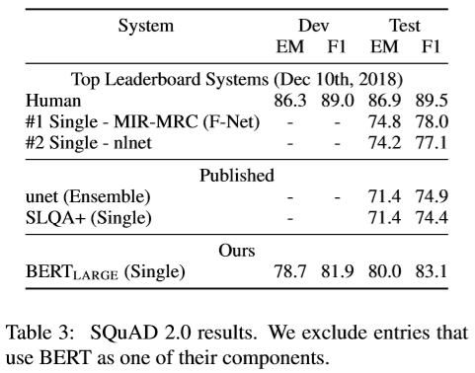
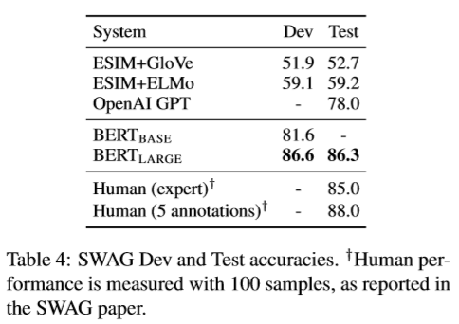
Experiments – SQuAD and SWAG

Slide 13
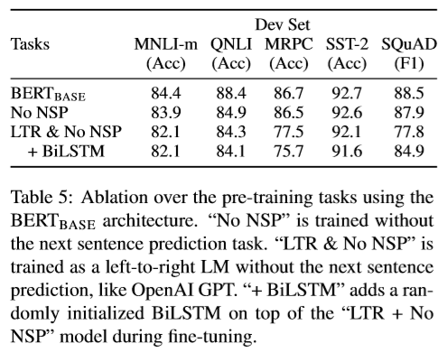
Ablation Studies – Effect of Pre-training Tasks
For SQuAD it is intuitively clear that a LTR model will perform poorly at token predictions, since the token-level hidden states have no rightside context. In order to make a good faith attempt at strengthening the LTR system, we added a randomly initialized BiLSTM on top. This does significantly improve results on SQuAD, but the results are still far worse than those of the pretrained bidirectional models. The BiLSTM hurts performance on the GLUE tasks.
We recognize that it would also be possible to train separate LTR and RTL models and represent each token as the concatenation of the two models, as ELMo does. However: (a) this is twice as expensive as a single bidirectional model; (b) this is non-intuitive for tasks like QA, since the RTL model would not be able to condition the answer on the question; (c) it is strictly less powerful than a deep bidirectional model, since it can use both left and right context at every layer.

Slide 14
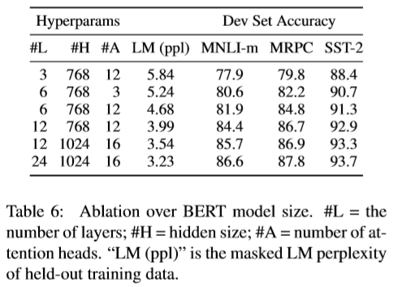
Ablation Studies – Effect of Model Size
We hypothesize that when the model is fine-tuned directly on the downstream tasks and uses only a very small number of randomly initialized additional parameters, the task-specific models can benefit from the larger, more expressive pre-trained representations even when downstream task data is very small.

Slide 15
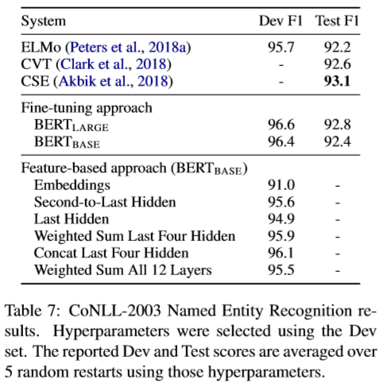
Ablation Studies – Feature-based Approach with BERT
BERT_{LARGE} performs competitively with state-of-the-art methods.
Feature-based approach：把BERT多个隐层的激活函数结果提取出来作为特征，后面接一个BiLSTM网络。The best performing method concatenates the token representations from the top four hidden layers of the pre-trained Transformer, which is only 0.3 F1 behind fine-tuning the entire model.
This demonstrates that BERT is effective for both finetuning and feature-based approaches.

Slide 16
Conclusion
BERT
Bidirectional
Unsupervised pre-training
Transfer learning
Allowing the same pre-trained model to successfully tackle a broad set of NLP tasks.

Slide 17
Question
SQuAD1.1的损失函数如何定义？
答：https://blog.csdn.net/hacker_long/article/details/104604146/，其中文中的S和E是引入的需要训练的代表起始点和终止点的权重vector。
2. Positional embedding在fine-tuning的时候如何做？
答：positional embedding不再使用transformer的三角函数表示，而是交给网络自己学习得到；segment embeddings和token embeddings同样是学习得到。
What is PPL?
答：https://zhuanlan.zhihu.com/p/44107044
4. BERT能不能做机器翻译？
答：不可以。可以做转述

Slide 18
Reference
[1] The code and pre-trained models are available at https://github.com/google-research/bert
[2] 什么是迁移学习 (Transfer Learning)？这个领域历史发展前景如何？https://www.zhihu.com/question/41979241
[3] BERT模型学习与分析 https://www.jianshu.com/p/160c4800b9b5
[4] BERT fine-tune 终极实践教程 https://www.jianshu.com/p/aa2eff7ec5c1

Slide 19
Thanks!

